Slide 1
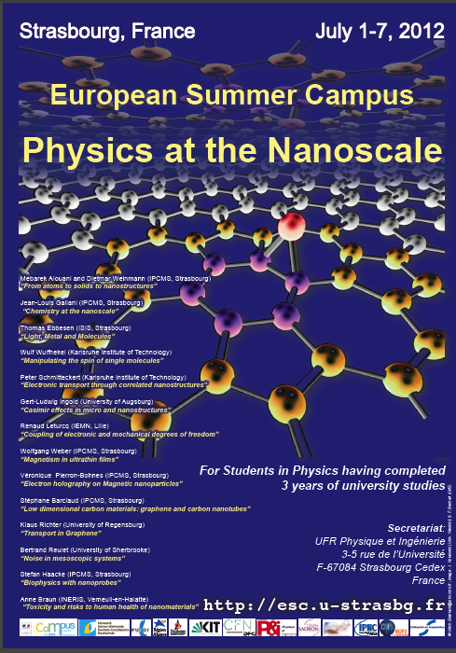

Slide 2
A Summer Campus What is it?
European Summer Universities were proposed by the French Minister of Education in 2000 to encourage the mobility of students within Europe. In spring 2009 the name of the programme changed to “Campus Européen d’Été” or “European Summer Campus”.
The 11th European Summer Campus on Physics at the Nanoscale is organised by the physics faculty of the University of Strasbourg (UdS), Centre for Functional Nanostructures of the Karlsruhe Institute of Technology (KIT) supported by several Institutes of the CNRS (IPCMS, ISIS and IPHC).
It is financed by the Minister for education and research, the German – French University (UFA), the University of Strasbourg and the region of Alsace and the city of Strasbourg.
The goal of the Summer Campus is twofold:
First we have a scientific programme explaining to you some of the exciting and very recent developments at the Nanoscale and their applications.
Second we would like to stimulate discussions between you, the other students, but also, very important, with the lecturers and the other researchers, who you will meet during this week.
We also have foreseen several excursions to give you the opportunity to learn about Europe, Strasbourg and Alsace.

Slide 3
Eric Westhof, Vice-president for Research Abdel-Mjid Nourreddine, Director of the UFR Physique et Ingénierie Rodolfo Jalabert Head of the Master programme in Physics

Slide 4
Organization
How does it work
Conference Secretariat, Monique Dell
Programme and Organizing Committee
Mebarek Alouani, Rodolfo Jalabert, Stefan Haacke and Ulrich Goerlach,
Wulf Wulfhekel, KIT- CFN
Technical Support
N. Busser (WWW), O. Hunzinger (PCs, WIFI)
N. Rudolf and Ch. Helfer (vidéo recording)
P. Gilbert, (Finance, papers)
S. Prohaska (Preparation of bags)
Many others (coffees etc.)

Slide 5
Scientific Programme
Sessions of (2x45+15min) lectures
Visit to the Institute of physics at the KIT
PLEASE DO ASK QUESTIONS!!!
Don’t be afraid to speak incorrect English
You are coming from 14 different countries with 20 different nationalities
Cultural and Social Programme
Important part of the European Summer Campus
Learn about Europe, the European Union and other countries (from the other students)
Learn about Alsace
Use the (little) free time to explore Strasbourg

