Slide 1
Toxicity and risks for human health of nanomaterials
Anne Braun
Head of the Experimental Toxicology Unit
INERIS Institut National de l’Environnement industriel et des RISques
(National Institute for industrial Environment and RISks)
anne.braun@ineris.fr

Slide 2
General organization of presentation
What is INERIS?
Toxicology and Nanotoxicology: definitions and context
Effects of nanoparticles on human health
  3.1. Entry routes
  3.2. Biological effects
Conclusion

Slide 3
What is INERIS?
National Institute
for industrial Environment and RISks.

Slide 4
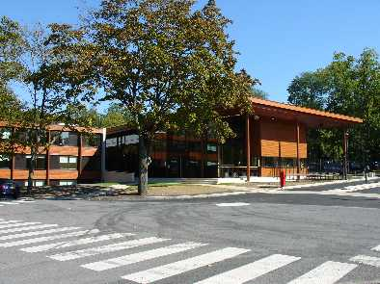
  INERIS: Public Institute with Industrial and Commercial goals.
Founded in 1960
600 employees, 50 PhD students
70 M€ revenues
  60% funding from the French Ministry of Ecology -governance
  40% contracts with private or public entities (including Europe)
Notes:
2

Slide 5

Organisation
INERIS

Slide 6
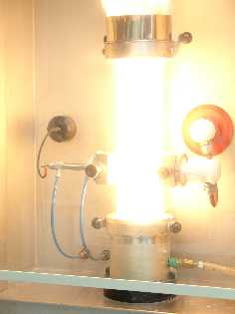
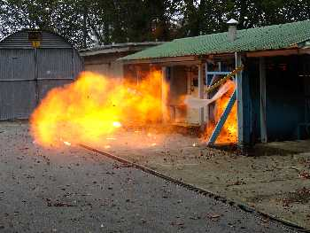
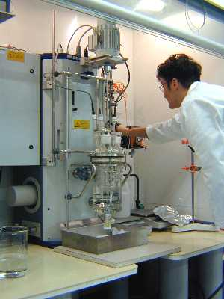
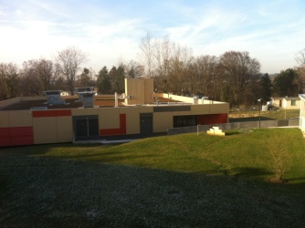
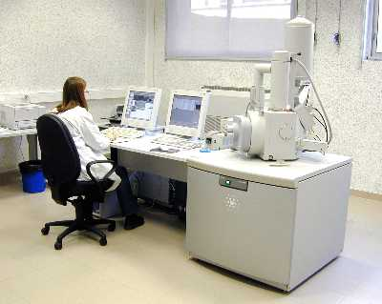
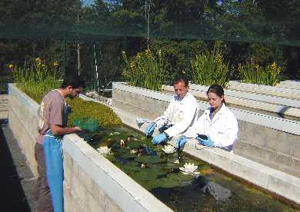
INERIS
Controlling risk for sustainable development
Prevention of industrial and technological risks.
Participation in the development, improvement , and sharing of best technologies and best practices.
Prevention of risks associated with chemical substances.

Slide 7
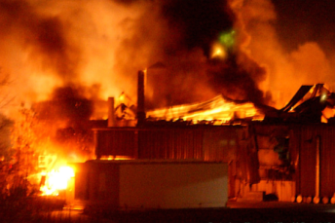
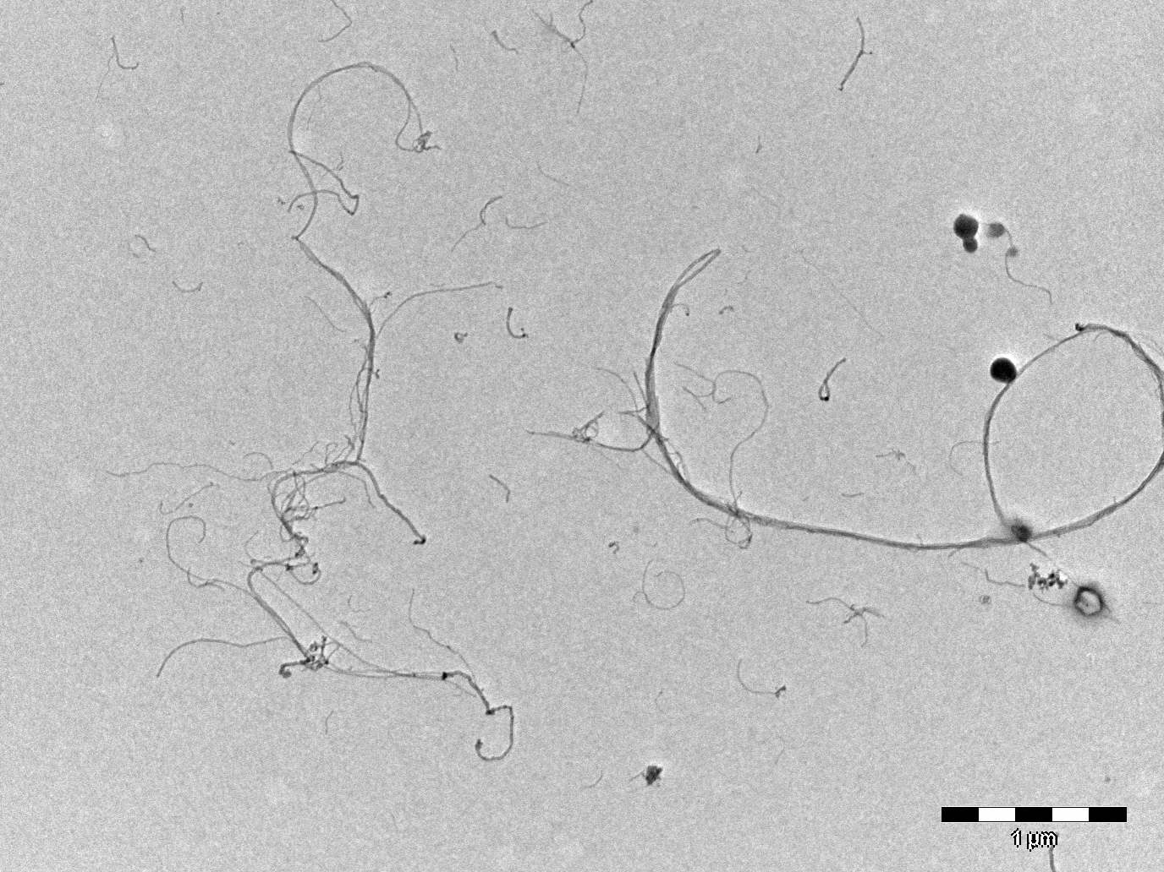
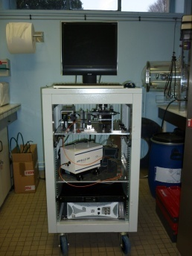
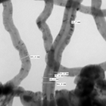
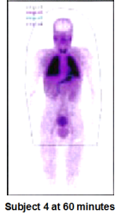
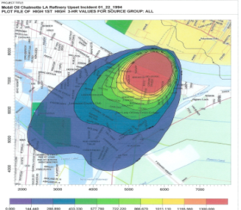
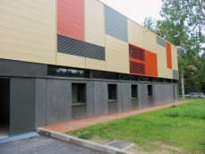
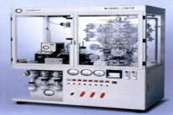
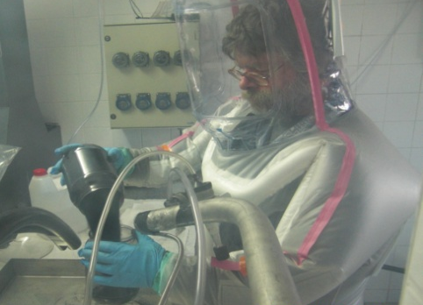
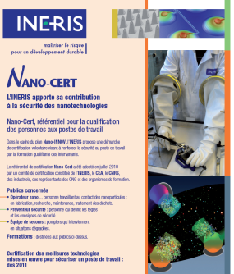
PROCESS SAFETY
Fire, explosion hazards
Loss of containment
Safety parameters (MIE, Kst…)
Molecular modeling QSPRs
INSTRUMENT DEVELOPMENTS
On-line monitoring (LIBS, LII, LIF)
Sampling techniques(microscopy, TEM)
Instrumental calibration, perf. evaluation
Nano generation and aerosolisation modules
PRODUCT CHARACTERIZATION
NANOBENCH
Physico-chemical properties (TEM, SEM…)
Dedicated equipments :
Use and ageing (mechanical stress…)
End of life (recycling)
Dedicated Installation for safe manipulation of nanoparticles (Halle nano, NanoBench)
MODELISATION
nucleation, agglomeration
Reactivity-Transport
TOXICOLOGY
Experimentation (stress, inflammation, genotoxicity..)
In vitro & In-silico (QSARs, TK, PBPK…)
Dedicated equipments (in-vitro, in-vivo inhalation)
INERIS TASK FORCE ON NANOTECHNOLOGIES Risk ASSESSMENT
Help Industries, Laboratories and Authorities to develop safer processes and products (emeric.frejafon@ineris.fr)
RISK ANALYSIS
“Control banding” tools
Semi-quantitative risk assessment
Safety barriers management & definition
I Intrinsic safety
ECOTOXICOLOGY
Experimental (Ageing, OECD tests…)
Dedicated equipments (mesocosm)
Dedicated GLP platforms
Exposition assessment
Occupational exposure
Accidental exposure scenarios
Environmental exposure
Expertise
Industries, public authorities
nanoREACH, ANSES
ISO, CEN & AFNOR
OECD – WPNM
SOCIO-ECONOMIC ANALYSIS
Integration of LCA and LCC results
Cost benefit & cost-efficiency analysis (CBA, CEA)
Multi-criteria analysis (MCA)
TRAINING
Workers, HS department, regulators
nanosafety
CERTIFICATION
NanoCert Workers
NanoCert MTD

Slide 8
Main goals of the Experimental Toxicology Unit
Assessment and prevention of hazards produced by
chemical and physical agents to human health
Assessment of the risks associated with exposure to non-ionising radiation (electromagnetic fields) via experimentation
Assessment of toxicologic effects of nanomaterials via experimentation.
Contribution (national level) to the implementation of the European legislation on chemical substances (REACh)

Slide 9
2) Toxicology and Nanotoxicology:
Definitions and Context

Slide 10
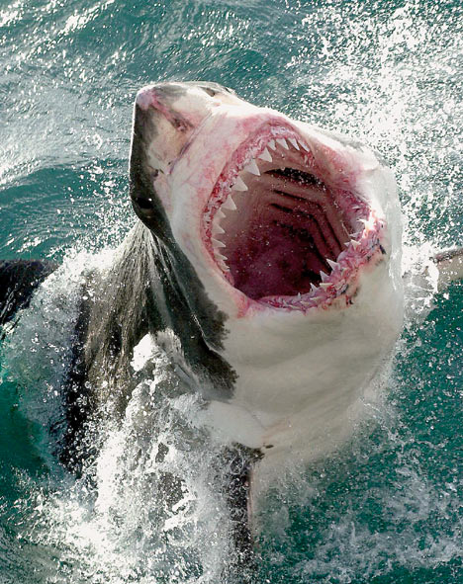
Definitions
              Toxicology = the science evaluating inherent dangers of substances.
                Risk = exposure x danger

Slide 11
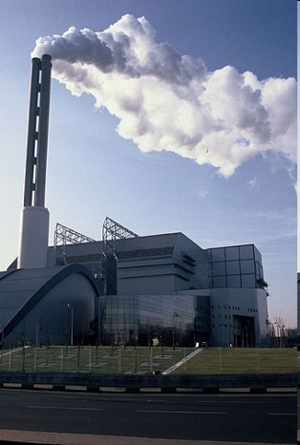
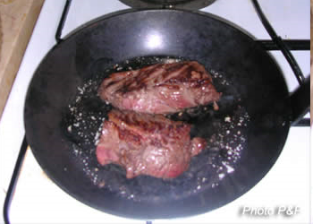
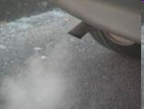
Ultrafine or Nanoparticles – General Notions
Ultrafine Particles:
defined by industry/ air pollution field (approx. 1990) as subfraction of generated particulate matter
size < 100 nm
incidental
Ultrafine Particles
Combustion processes (23%)
Industrial
Domestic
Transport (60%)

Slide 12
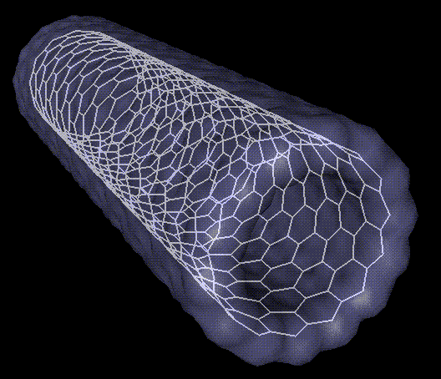
Ultrafine or Nanoparticles – General Notions
Manufactured Nanoparticles:
linked to the development of nanotechnologies
Engineered particles
Nanomaterial = OECD definition
« Material composed of one or several components having at least one dimension is in the nanometric order of magnitude »

Slide 13
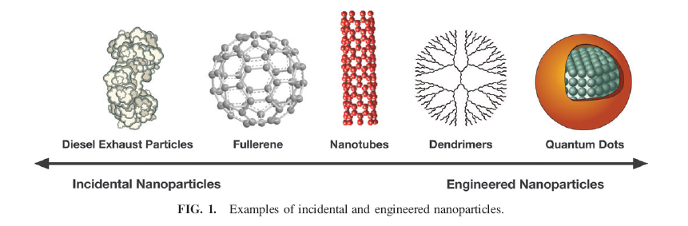
Nanoparticles
Recent wording and definitions, but interactions between life and nanoparticles are not as recent...
Carbon Nanotubes found in glacier carrots in Greenland (néolithic - 10 000 years)
Nanotubes and fullerenes , found from combustion processes (natural gaz, propane...)
Stern ST, McNeil SE (2008). Nanotechnology safety concerns revisited. Toxicological Sciences, 101(1), 4-21.

Slide 14
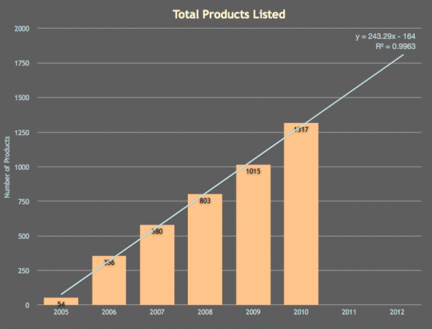
Nanotechnology consumer products inventory
March 10, 2011:
1317 products or product lines.
521% growth
March 2006 =>March 2011
http://www.nanotechproject.org/inventories/consumer/analysis_draft/

Slide 15
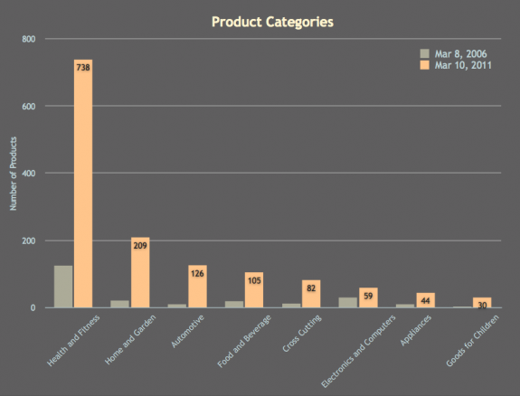
Nanoparticles in consumer products
cosmetics - sunscreens
paints
coatings
http://www.nanotechproject.org/inventories/consumer/analysis_draft/

Slide 16
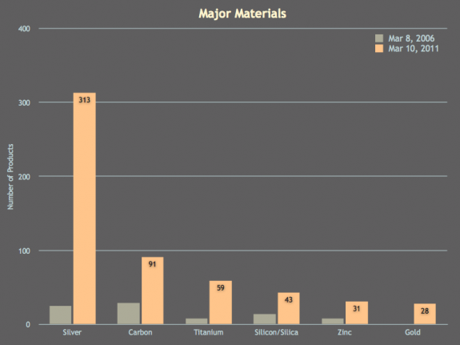
Nanoparticles in consumer products
Most common material :
silver
Carbon (including fullerenes)
titanium (including titanium dioxide)
silica
zinc (including zinc oxide)
gold
http://www.nanotechproject.org/inventories/consumer/analysis_draft/

Slide 17
Why is risk evaluation of nanoparticles necessary?
Exponential development of nanotechnologies,
increased new particles/extreme diversity,
increased presence of nanomaterials in usual consumer products,
Risk = exposure x danger
Increased exposure of people (professional and general population)
« Is the field moving so fast that it's destined to repeat the mistakes of earlier technological revolutions? »
Service RF (2004). Nanotechnology grows up. Science, 304, 1732-1734.

Slide 18
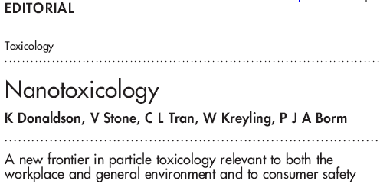
“We therefore propose that a new subcategory of toxicology—namely nanotoxicology—be defined to address gaps in knowledge and to specifically address the special problems likely to be caused by nanoparticles”.

Slide 19
3) Effects on human health
3.1. Entry routes
Absorption/Distribution (Target organs determination) /Metabolism/Elimination

Slide 20
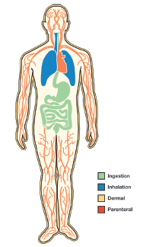
Entry routes
Inhalation : main route
Oral route: via feeding (eg food packaging nanoparticles), via ingestion of inhaled particles
Dermal route : via cosmetics...

Slide 21
Inhalation: Nanoparticles elimination
Pulmonarian clearance :
mucociliated escalator
phagocytosis by macrophages
Alveolar cells
Nanoparticles
For the same mass of particles:
=> More deposition
=> Increased passage
=> Macrophages behavior?
Fine particles

Slide 22
Inhalation:
Nanoparticles elimination vs transfer to the body
Studies on rodents have shown that the nanoparticles deposited in the lungs can enter into the pulmonary interstitium
Macrophages
Pulmonary interstitium
(Oberdörster, 1992, 2000)

Slide 23
Inhalation:
Nanoparticles transfer to the body
Concerning transfer of nanoparticles, the evidence is conflicting…
  Oberdorster, 2002 : 50% transfer (liver). NPs ¹³C (20-29 nm)
  Kreyling, 2002 : < 1% transfer (Ir, 15 et 80 nm, IT)
  Takenaka, 2005 : < 1% transfer (Au, 10 nm)
Nanoparticles can deposit in the respiratory tract after inhalation.
Nanoparticle translocation into the systemic circulation may occur after inhalation, but conflicting evidence is present on the extent of translocation.
=> additional studies are needed to further elucidate these findings and to characterize the physiological impact.

Slide 24
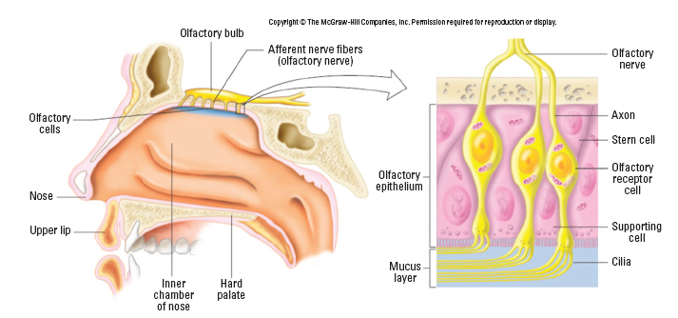
A particular entry route: neuronal translocation
Bulbe olfactif
Nerf olfactif
Nerf olfactif
Axone
Neurones olfactifs
Epithélium
olfactif
Neurones olfactifs
Nose
Lèvre supérieure
Mucus
Cils
Chambre
nasale
Palais dur
A few reports indicate uptake of nanoparticles in the brain via the olfactory epithelium.
D’après Oberdörster, 1994

Slide 25
Dermal route
Numerous studies of nanoparticles penetration through the skin:
TiO₂ – sunscreens
No clear penetration beyond stratum corneum
Beryllium (500 nm - 1 µm)
  With skin agitation: penetration to the dermis (pig, in vitro)
Quantum dots
  Limited penetration to the dermis (pig, in vitro), depending on size/shape/charge
Little evidence that dermal applications of metal oxide nanoparticles used in sunscreens lead to systemic exposure.
However, usual testing is done with healthy, intact skin…
BUT, what if the skin presents lesions???

Slide 26
Absorption through the gut
By definition, function of the gut is to absorb exogenous substances
Charge of particles is crucial (mucus negatively charged)
Penetration speed correlates with the size (14 nm/2 min, 415 nm/30 min, 1µm/0) (Szentkuti, 1997)
Passage possible through lymphatic vessels and capillaries
(eg: polystyrene : 50 nm 34%, 100 nm 26%) (Jani, 1990)
Systemic absorption is low (Jani, 1990)
Uptake of nanoparticles in the gastrointestinal tract after oral uptake exists.
Sometimes intentionally made in the design of food and pharmacological components.

Slide 27
3) Effects on human health
3.2. Biological effects
(cellular stress, inflammation, tumours…)

Slide 28
Toxicity and potential mechanisms
Toxicity evaluation: human (epidemiology); animal models (in vivo); cellular models (in vitro); computer modelization (in silico)
Epidemiology: downstream
In vivo: still most accurate results, but death assessment is the key parameter
In vitro: assessment of cytotoxicity(cell death)… predictivity?
In silico: still requires other approaches in combination
In general, two processes are involved in the toxicity of particles:
Inflammatory processes Oxydative stress
(generation of oxygen radicals)
Pulmonary diseases, tumours…

Slide 29
Inhalation toxicity
For most manufactured nanoparticles, no toxicity data is available.
Available toxicity data is generated with a small set of nanoparticles, known for years, high production level:
  carbon black (CB),
  titanium dioxide (TiO2),
  iron oxides,
  amorphous silica.
Observations: upon prolonged exposure (inhalation) in rats, inflammation and lung tumours can occur.

Slide 30
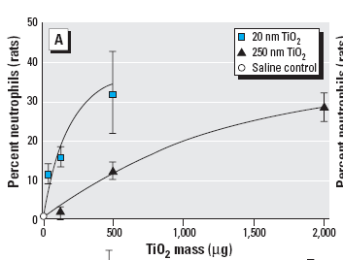
Example: effects of TiO2 nanoparticles on inflammation, after respiratory exposure
For a same mass, and similar chemical composition (TiO₂, carbone black), nanoparticles (14-21 nm) are more toxic than bigger particles (250-320 nm) from the same nature (Ferin, 1992 ; Oberdorster, 1994 ; Li, 1999…)
Marker of inflammation
Adapted from Oberdörster, 1994

Slide 31
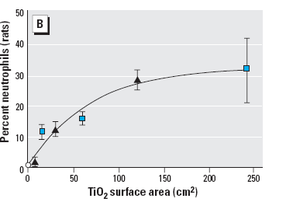
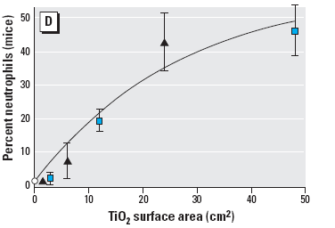

Example: effects of TiO2 nanoparticles on inflammation, after respiratory exposure
If the same results are expressed in particle surface area, dose-response curves are similar, suggesting surface area is involved in pulmonary inflammation
Marker of inflammation
Adapted from Oberdörster, 1994

Slide 32
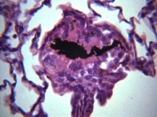
Effect of carbon nanotubes purity on pulmonary toxicity after respiratory exposure (rats)
Elgrabli D, Trouiller B, Rogerieux F and Lacroix G.
SwCNT raw (20% iron) or purified (2% iron) (CNI)
1 instillation (200 µg)
Macrophages phagocyte raw CNTs faster than purified CNTs
Raw CNTs induce more granulomas (and bigger) than purified CNTs.
Markers of oxydative stress, inflammation and apoptosis are increased after instillation of purified CNTs.

Slide 33
Respiratory effects of nanomaterials : conclusion
However, again, this can not be generalized…
2006 (Sayes et al.) : the cytotoxic and inflammatory effects of TiO₂ nanoparticles are independent from size and surface area of the particle.
2006, 2007 (Warheit et al.) : inflammatory effects of quartz (12-500 nm) nanoparticles, in rats, are not correlated with size or surface area, but with surface reactivity. Changes in surface reactivity lead to different hemolytic potential.
=> Surface properties (not only surface area) are crucial
Purity and other specifics also play a role

Slide 34
Systemic effects of nanoparticules
Limited number of studies: on specific nanomaterials. mostly acute studies done; few long-term chronic studies.
Target organs not always identified
Tested materials not sufficiently characterized
Examples of tested nanomaterials: fullerenes, CNT, dendrimers, Fe₃O₄, Zn, Cu, TiO₂, quantum dots...
General observations:
  Toxic dose (DL₅₀) :order of magnitude: mg-g/kg: slightly to moderately toxic
  Usually no mortality
  Target organs: liver, spleen and kidney

Slide 35
Nanoparticles and cancer: examples
Fullerenes
Dermal route
  Application on skin of mice (Nelson, 1993)
No tumours found (dose of 200 µg of fullerene, 2 times/week, 24 weeks)
  Confirmed by in vitro mutagenesis tests (dose --> 5 mg/ml) (Mori, 2006)
Multiwall Carbon Nanotubes
Injection in abdominal mesothelium in mice: similar response than with asbestos (Takaji, 2008 ; Poland, 2008)
  Tissue lesions similar to mesothelioma (25 weeks after injection) . No effect of fullerenes (Takaji, 2008).
  Short term effects: Inflammation (24h ) and granulomas (7 days) observed after exposure to long, straight, carbon nanotubes and asbestos. No effect seen with short, non fibrous, nanotubes and carbon black (Poland, 2008).
=> Variable results based on the nanoparticles specific characteristics

Slide 36
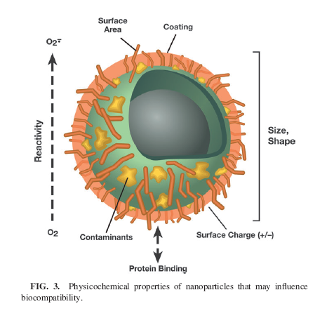
Conclusion: Nanoparticles physico-chemical
properties that may influence toxicity
Identity of the nanoparticle when in a biological medium
CAUTION: Big difference between physico-chemical identity of a nanoparticle and its biological identity

Slide 37
To reach accurate danger evaluation:
Importance of thorough and exhaustive characterization of physico-chemical properties of the studied nanoparticles (size, shape, agglomeration, solubility, surface properties…)
Experimental conditions and how they can influence/modify the nanoparticles properties need to be defined (eg: addition of dispersion agents…)
Identification of properties that determine the toxicity of the nanomaterials
Allow/facilitate comparison between studies

Slide 38
What next?
A lot of work to do!!!
  Identify toxic effects
  Clarify the specifics that determine toxicity => try to define nanoparticles families => « safer by design » nanoparticles
  exposure evaluation: occupational + general population
  Lifecycle
Given the notable lack of information, current recommendations are largely based on common sense:
  minimize exposure and hazards,
  use the knowledge by analogy to ultrafine material toxicity
  general health and safety recommendations (fume hoods, protective equipment…)

Slide 39
Conclusion
Experimental studies with some bulk nanoparticles (carbon black, titanium dioxide, iron oxides) used for decades suggest various adverse effects.
Engineered nanomaterials with new chemical and physical properties are being produced constantly and the toxicity of these is unknown.
NO blanket statements about human toxicity can be given at this time.
AND… impact of Nanoparticles on ecosystems and environnment??

